Slide 1
Data Warehousing Concepts & Tools

Slide 2

Data warehousing Concepts & Tools
Session 4
Trainer: Ms Shirley Komogi

Slide 3
Contents
What is Data warehouse?
Characteristics of Data warehouse

Slide 4
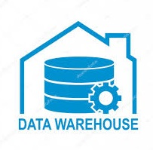

What is Data warehouse?
Data Warehousing is the process of compiling and organizing data into one common database.
It is similar to Data mining but NOT the SAME.
Notes:
The primary difference between data warehousing and data mining is that Data Warehousing is the process of compiling and organizing data into one common database, whereas data mining refers the process of extracting meaningful data from that database. The two concepts are interrelated; data mining begins only after data warehousing has taken place.

Slide 5
Data warehouse comprises of:
A data warehouse environment includes:
an extraction, transportation, transformation, and loading (ETL) solution,
an online analytical processing (OLAP) engine,
client analysis tools,
and other applications that manage the process of gathering data and delivering it to business users.

Slide 6
What is Data warehouse?
A data warehouse is a relational database that is designed for query and analysis rather than for transaction processing.

